Slide 1


STUDENT RECORD MANAGEMENT SYSTEM

Slide 2
NAME(S) OF STUDENTS AND ID
1 | Yahye iise Mohamed | 7783
2 | Abdi salaam Ahmed Mohamed | 10489
3 | Abdullahi Awil Mohamed | 8511
4 | Khaalid nabiil Ali | 8417
5 | Yusuf Guled Mohamed | 8831
6 | Abdullahi Ahmed Hayow | 8769
7 | Abdullahi Farah Ali | 9112
8 | Abdulkadir Mohamed Abdule | 8591
9 | Abdirahman Ahmed Alasow | 8965

Slide 3
CHAPTER ONE INTRODUCTION
Background Of Study
Problem Statement
Research Question
Scope Of Project

Slide 4
BACKGROUND OF STUDY
The background of student record management systems can be traced back to the emergence of computer technology and the need for educational institutions to streamline their administrative processes. In the past, student records were primarily maintained on paper, which made it difficult to organize and retrieve information quickly. With the advent of computers and databases, schools began to explore digital solutions to manage student data more effectively.
Early versions of student record management systems were simple and focused on basic functionalities like storing student names, addresses, and grades. However, as technology advanced, these systems evolved to include more comprehensive features and capabilities. Today, modern student record management systems are sophisticated software applications that integrate various modules and functionalities to support multiple aspects of student administration

Slide 5
PROBLEM STATEMENT
The current education system generates a massive amount of student data that needs to be efficiently managed and maintained. However, traditional methods of record-keeping, such as paper-based systems or disconnected spreadsheets, pose numerous challenges and limitations. These include:
1. Data Disorganization: Managing student records manually leads to disorganized data, making it difficult to find specific information in a timely manner. This can result in delays and errors in administrative processes, such as enrolment, grading, and generating reports.
2. Limited Accessibility: Paper-based records or local spreadsheet systems restrict access to authorized personnel only, making it inconvenient for multiple stakeholders, such as teachers, administrators, parents, and students, to access and update student information. This lack of accessibility hampers collaboration and efficient communication.
3. Data Security Risks: Storing student records in physical files or local systems makes them vulnerable to loss, damage, or unauthorized access. The mishandling of sensitive student information, such as grades, attendance, and personal details, can lead to privacy breaches and legal implications.

Slide 6
RESEARCH QUESTION
1. How to identify the usage of Student Record Management System?
2. How to analysis the requirements of Student Record Management System?
3. How to design and implementation of Student Record Management System?

Slide 7
SCOPE OF PROJECT
1. Time scope of project started March 15th, up to July 2023
2. The content of scope of project should be front end PHP and back end MYSQL server

Slide 8
CHAPTER TWO LITEATURE REVIEW
Concept of the project
Existing system

Slide 9
CONCEPTS OF STUDENT RECORD MANAGEMENT SYSTEM
Student record management systems have become increasingly popular in educational institutions in recent years. These systems are designed to simplify the process of storing, retrieving, updating, and managing the records of students. Several studies have been conducted on the use of student record management systems, and their impact on educational institutions.
One study by Hussain et al. (2018) explored the use of a student record management system in a Pakistani university. The study found that the system improved the efficiency of record management and reduced the workload of administrative staff. It also improved communication between students, faculty, and administrative staff, and provided students with easy access to their academic records..

Slide 10
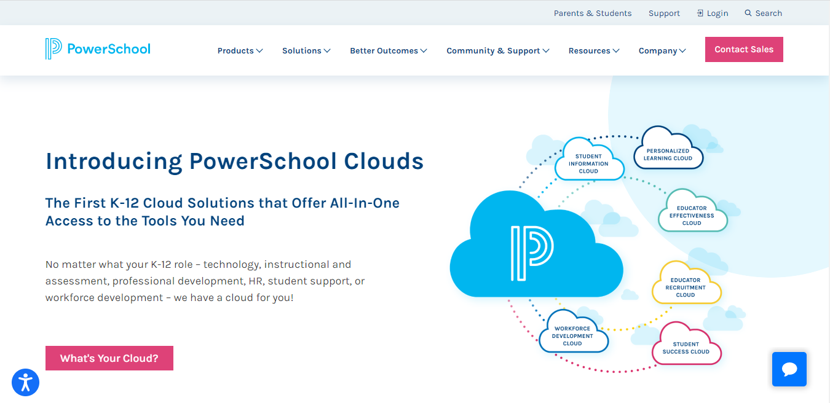
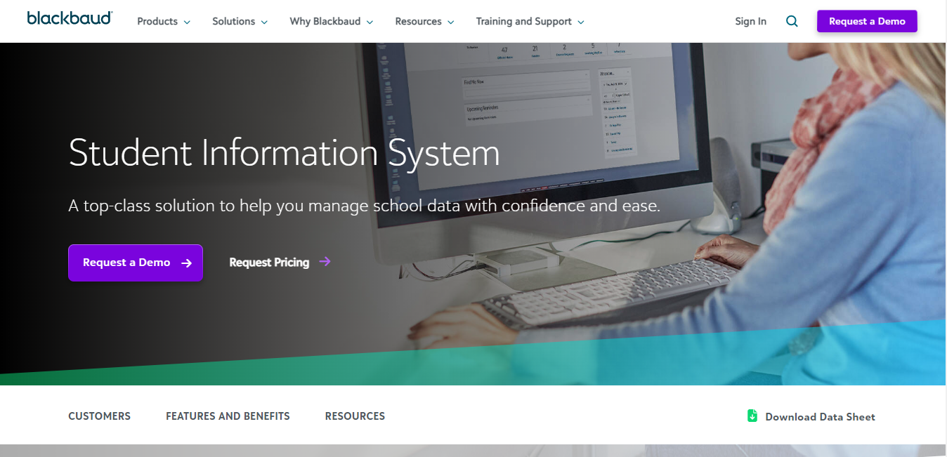
EXISTING SYSTEM
There are several existing student record management systems available in the market. Some of the most popular ones are:
Indian PowerSchool 2. Blackboud
Figure 2.1. https://PowerSchool.com Figure https://blackbaud.com/

Slide 11
Data Gathering Feasibility Study Solution Strategy Data flow Diagram New proposed system
CHAPTER THREE REQUIREMENT ANALYSIS

Slide 12
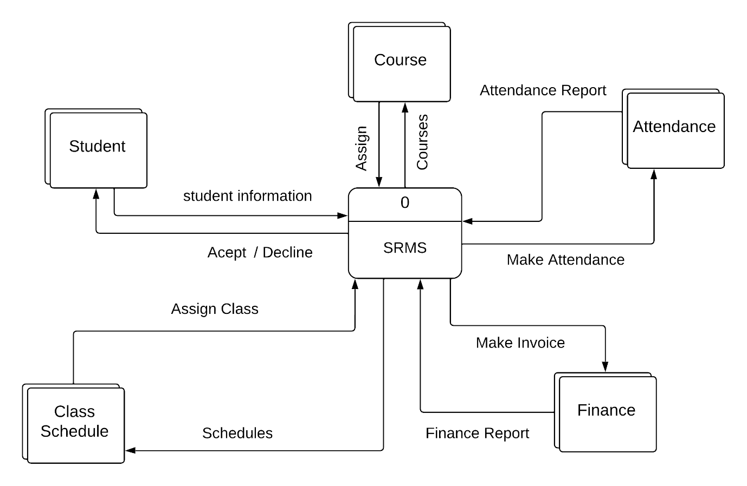
Data flow diagram
DATA FLOW DIAGRAM – CONTEXT DIAGRAM (level 0)

Slide 13
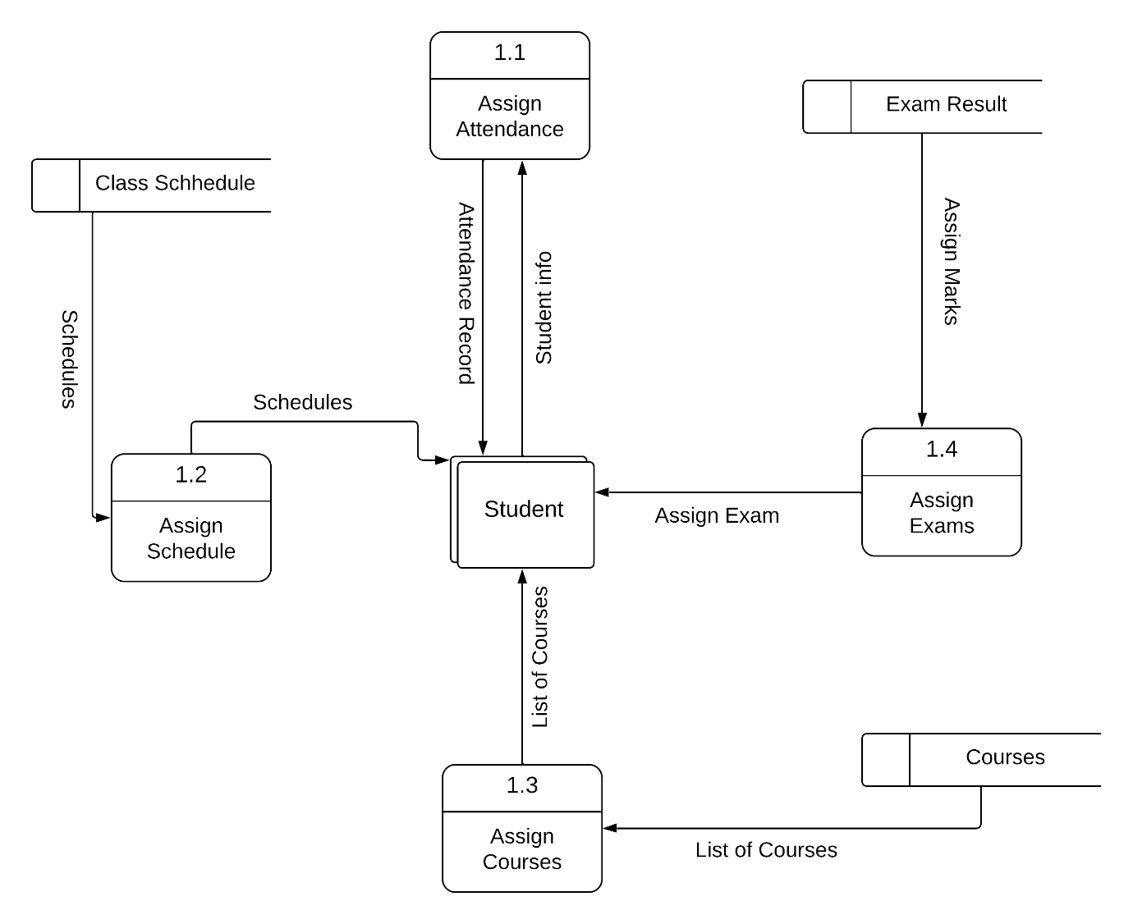
DFD – LEVEL 1- WHOLE FRAME-WORK OF SYSTEM

Slide 14
Chapter IV- System Design
1.Database design
2.Entity relationship Diagram (ERD)
4.Table design

Slide 15
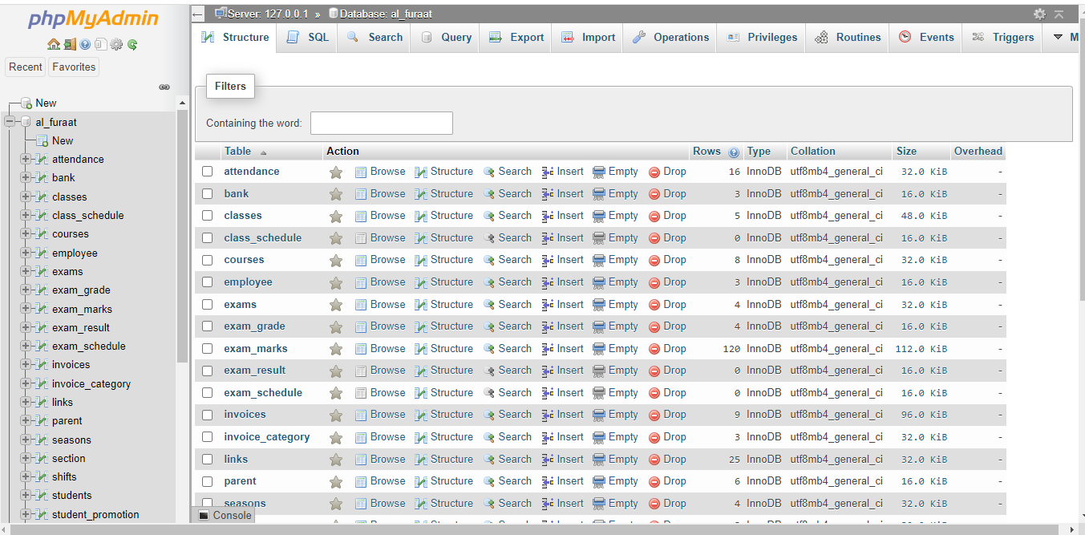
Database design
Design is the process of producing a detailed data model of a database. This logical data model contains all the needed logical and physical design choices and physical storage parameters needed to generate a design in a Data Definition Language, which can then be used to create a database. A fully attributed data model contains detailed attributes for each entity.

Slide 16
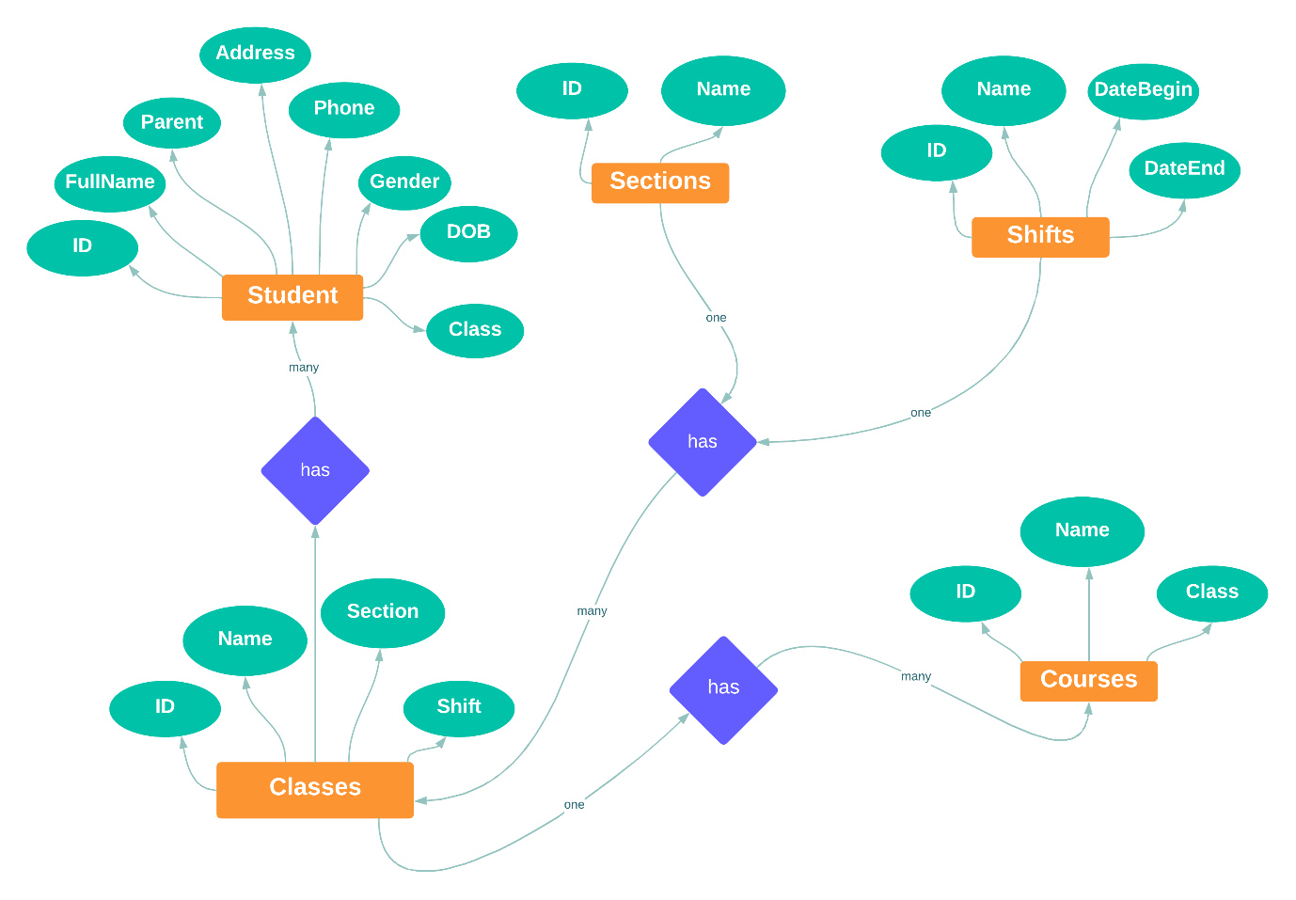
ENTITY RELATIONSHIP DIAGRAM (ERD)

Slide 17
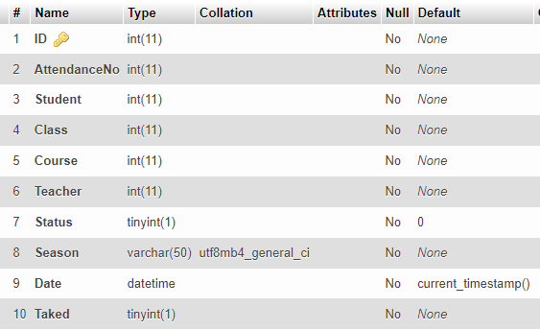
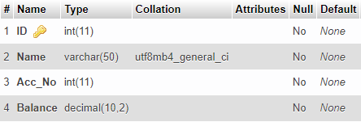
Table design

Slide 18
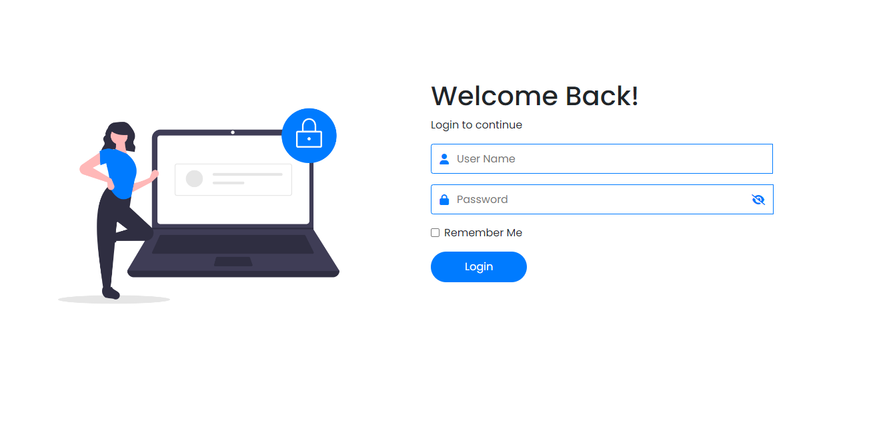
login
CHEPTER FIVE

Slide 19
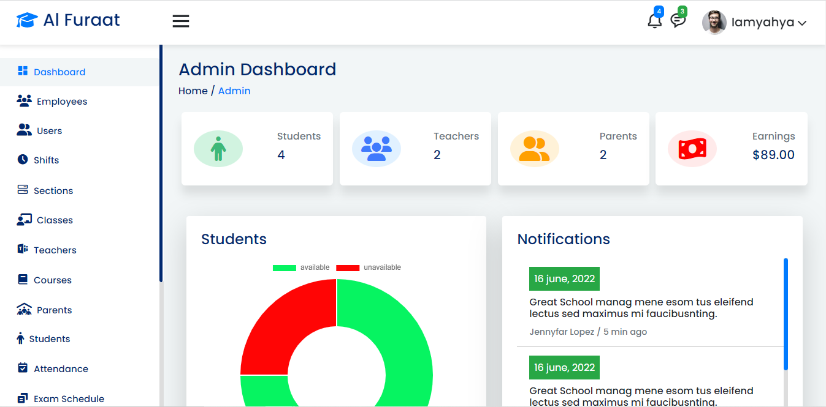
Home Page of Admin

Slide 20
Chapter VI- Conclusion & Recommendation
Conclusion
1.Achievements:
Every project has some strengths and weaknesses; so, we would like to identify some of the strengths and good features that student record management system will provide to the users. This system is very friendly system and it has a good interface that can be usable by every person who is computer literate. Moreover, if the user make a mistake it generate an error message that easily understandable by the user and it gives you the necessary utilities in you project, and other tools that you may need while you are working with the project. Our system has a capability to work 24hrs with addition and provides sufficiency and effective work and has equivalent storage.

Slide 21
Continue…
2.Limitations
On the other hand, every project has its own Limitations, so, In this project, the only problems that you might face is alerting messages that appear whenever you misuse to the system, and if you are not familiar with this system you might find it difficult to manage it, please don't confuse, just read carefully what the message is carrying out and then click on the appropriate button. This system may only get problem towards the restriction format when using admin and user.

Slide 22
Continue…
3.Future enhancement:
This project was developed by using different types of software, so, If some one tries to develop this project ,or enhance some of its functionalities and features , he/she should be able to know how to use PHP,MYSQL

Slide 23
REFERENCE
1. Basse, S., Okodoko, D., & Akpanumo, U. (2009). African Research Review. Information Communication Technologies in the Management of Education for Sustainable Development in Africa,3, 414-428.
2. Bunoti, S. (2004). The quality of higher education in developing countries needs professional support
3. C.R, Kothari. (2004). Research methodology methods and techniques. (Second ed., p. 100). India: NEW AGE INTERNATIONAL (P). DOI: www.newagepublishers.com
4. Carcary M, Long G and Remenyi D (2007) “The Implementation of a New Student Management Information System (MIS) at an Irish Institute of Technology – An Ex Post Evaluation of its Success” The Electronic Journal Information Systems Evaluation Volume 10 Issue 1, pp 31 - 44, available online at www.ejise.com
5. Chifwep, V. (1995).Managing records at school level. National Education Statistical Information Systems.

Slide 24
END

